Slide 1
layout
Taught by Yossef Ayman Zedan

Slide 2
Utilities
We can add div with margins to separate between each field within the form.
<div class="mb-3"> <label for="formGroupExampleInput" class="form-label">Example label</label> <input type="teXxt" class="form-control" id="formGroupExampleInput" placeholder="Example input placeholder"> </div> <div class="mb-3"> <label for="formGroupExampleInput2" class="form-label">Another label</label> <input type="text" class="form-control" id="formGroupExampleInput2" placeholder="Another input placeholder"> </div>

Slide 3
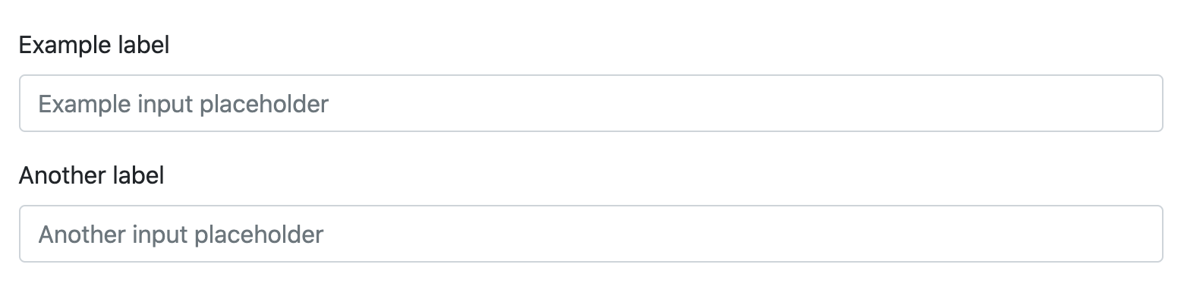
Utilities

Slide 4
Form grid
We can add row, columns inside the form.
<div class="row"> <div class="col"> <input type="text" class="form-control" placeholder="First name”> </div> <div class="col"> <input type="text" class="form-control" placeholder="Last name”>
</div> </div>

Slide 5
Gutters
you can have control over the gutter width in as well the inline as block direction by adding gutters
<div class="row g-3"> <div class="col"> <input type="text" class="form-control" placeholder="First name">
</div> <div class="col"> <input type="text" class="form-control" placeholder="Last name">
</div> </div>

Slide 6
More complex layout
<form class="row g-3"> <div class="col-md-6"> <div class="col-md-6"> <input type="email" class="form-control" id="inputEmail4"> </div> <div class="col-md-6"> <label for="inputPassword4" class="form-label">Password</label> <input type="password" class="form-control" id="inputPassword4"> </div> <div class="col-12"> <label for="inputAddress" class="form-label">Address</label> <input type="text" class="form-control" id="inputAddress" placeholder="1234 Main St"> </div> <div class="col-12"> <label for="inputAddress2" class="form-label">Address 2</label> <input type="text" class="form-control" id="inputAddress2" placeholder="Apartment, studio, or floor"> </div>

Slide 7
More complex layout
<div class="col-md-6"> <label for="inputCity" class="form-label">City</label> <input type="text" class="form-control" id="inputCity"> </div> <div class="col-md-4"> <label for="inputState" class="form-label">State</label> <select id="inputState" class="form-select"> <option selected>Choose...</option> <option>...</option> </select> </div> <div class="col-md-2"> <label for="inputZip" class="form-label">Zip</label> <input type="text" class="form-control" id="inputZip"> </div>

Slide 8
More complex layout
<div class="col-12"> <div class="form-check"> <input class="form-check-input" type="checkbox" id="gridCheck"> <label class="form-check-label" for="gridCheck"> Check me out </label> </div> </div> <div class="col-12"> <button type="submit" class="btn btn-primary">Sign in</button> </div> </form>

Slide 9
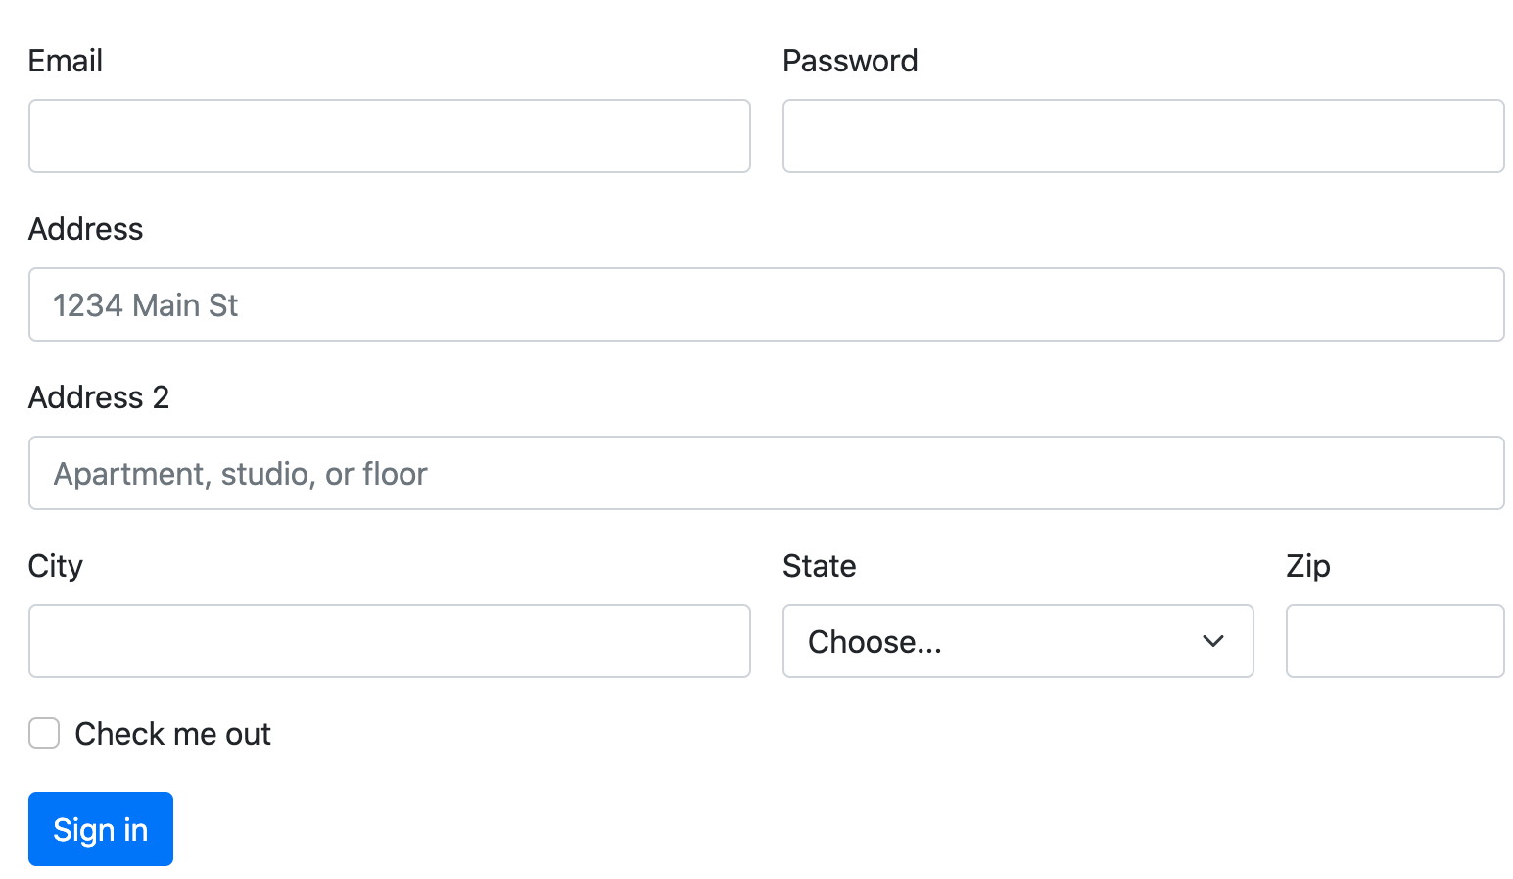
More complex layout

Slide 10
Horizontal form
Create horizontal forms with the grid by adding the .row class to form groups and using the .col-*-* classes to specify the width of your labels and controls. Be sure to add .col-form-label to your <label>s as well so they’re vertically centered with their associated form controls.
At times, you maybe need to use margin or padding utilities to create that perfect alignment you need. For example, bootstrap has removed the padding-top on stacked radio inputs label to better align the text baseline
Source code:
<form> <div class="row mb-3"> <label for="inputEmail3" class="col-sm-2 col-form-label">Email</label> <div class="col-sm-10"> <input type="email" class="form-control" id="inputEmail3"> </div> </div>

Slide 11
Horizontal form
<div class="row mb-3"> <label for="inputPassword3" class="col-sm-2 col-form-label">Password</label> <div class="col-sm-10"> <input type="password" class="form-control" id="inputPassword3"> </div> </div> <fieldset class="row mb-3"> <legend class="col-form-label col-sm-2 pt-0">Radios</legend> <div class="col-sm-10"> <div class="form-check"> <input class="form-check-input" type="radio" name="gridRadios" id="gridRadios1" value="option1" checked> <label class="form-check-label" for="gridRadios1"> First radio </label> </div>

Slide 12
Horizontal form
<div class="form-check"> <input class="form-check-input" type="radio" name="gridRadios" id="gridRadios2" value="option2"> <label class="form-check-label" for="gridRadios2"> Second radio </label> </div> <div class="form-check disabled"> <input class="form-check-input" type="radio" name="gridRadios" id="gridRadios3" value="option3" disabled> <label class="form-check-label" for="gridRadios3"> Third disabled radio </label> </div> </div> </fieldset>

Slide 13
Horizontal form
<div class="row mb-3"> <div class="col-sm-10 offset-sm-2"> <div class="form-check"> <input class="form-check-input" type="checkbox" id="gridCheck1"> <label class="form-check-label" for="gridCheck1"> Example checkbox </label> </div> </div> </div> <button type="submit" class="btn btn-primary">Sign in</button> </form>

Slide 14
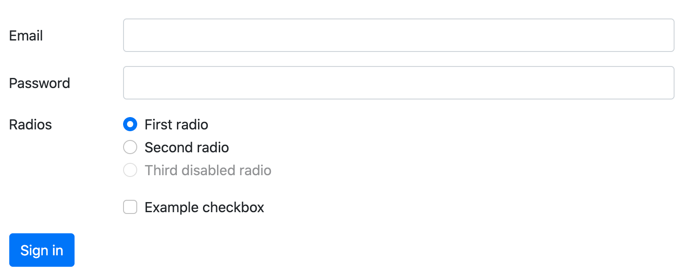
Horizontal form

Slide 15
Horizontal form label sizing
Be sure to use .col-form-label-sm or .col-form-label-lg to your <label>s or <legend>s to correctly follow the size of .form-control-lg and .form-control-sm.
Source code:
<div class="row mb-3"> <label for="colFormLabelSm" class="col-sm-2 col-form-label col-form-label-sm">Email</label> <div class="col-sm-10"> <div class="col-sm-10"> </div> </div> <div class="row mb-3"> <label for="colFormLabel" class="col-sm-2 col-form-label">Email</label> <div class="col-sm-10"> <input type="email" class="form-control" id="colFormLabel" placeholder="col-form-label"> </div> </div>

Slide 16
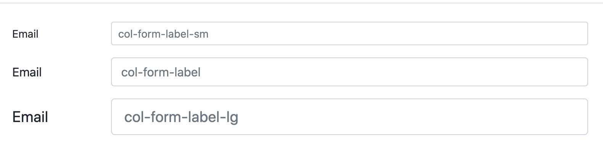
Horizontal form label sizing
<div class="row"> <label for="colFormLabelLg" class="col-sm-2 col-form-label col-form-label-lg">Email</label> <div class="col-sm-10"> <input type="email" class="form-control form-control-lg" id="colFormLabelLg" placeholder="col-form-label-lg"> </div> </div>

Slide 17
Column sizing
As shown in the previous examples, our grid system allows you to place any number of .cols within a .row. They’ll split the available width equally between them. You may also pick a subset of your columns to take up more or less space, while the remaining .cols equally split the rest, with specific column classes like .col-sm-7.
<div class="row g-3"> <div class="col-sm-7"> <input type="text" class="form-control" placeholder="City" aria-label="City"> </div> <div class="col-sm"> <input type="text" class="form-control" placeholder="State" aria-label="State"> </div> <div class="col-sm"> <input type="text" class="form-control" placeholder="Zip" aria-label="Zip"> </div> </div>

Slide 18
Column sizing

Slide 19
Auto-sizing
The example below uses a flexbox utility to vertically center the contents and changes .col to .col-auto so that your columns only take up as much space as needed. Put another way, the column sizes itself based on the contents.
<form class="row gy-2 gx-3 align-items-center"> <div class="col-auto"> <input type="text" class="form-control" id="autoSizingInput" placeholder="Jane Doe"> </div> <div class="col-auto"> <div class="input-group"> <div class="input-group-text">@</div> <input type="text" class="form-control" id="autoSizingInputGroup" placeholder="Username"> </div> </div>

Slide 20
Auto-sizing
<div class="col-auto"> <select class="form-select" id="autoSizingSelect"> <option selected>Choose...</option> <option value="1">One</option> </select> </div> <div class="col-auto"> <div class="form-check"> <input class="form-check-input" type="checkbox" id="autoSizingCheck"> <label class="form-check-label" for="autoSizingCheck"> Remember me </label> </div> </div> <div class="col-auto"> <button type="submit" class="btn btn-primary">Submit</button> </div> </form>

Slide 21

Auto-sizing

Slide 22
Auto-sizing
You can then remix that once again with size-specific column classes.
<form class="row gx-3 gy-2 align-items-center"> <div class="col-sm-3"> <input type="text" class="form-control" id="specificSizeInputName" placeholder="Jane Doe"> </div> <div class="col-sm-3"> <div class="input-group"> <div class="input-group-text">@</div> <input type="text" class="form-control" id="specificSizeInputGroupUsername" placeholder="Username"> </div> </div>

Slide 23
Auto-sizing
<div class="col-sm-3"> <select class="form-select" id="specificSizeSelect"> <option selected>Choose...</option> <option value="1">One</option> </select> </div> <div class="col-auto"> <div class="form-check"> <input class="form-check-input" type="checkbox" id="autoSizingCheck2"> <label class="form-check-label" for="autoSizingCheck2"> Remember me </label> </div> </div> <div class="col-auto"> <button type="submit" class="btn btn-primary">Submit</button> </div> </form>

Slide 24

Auto-sizing

Slide 25
Inline forms
Use the .row-cols-* classes to create responsive horizontal layouts. By adding gutters, we’ll have gutters in horizontal and vertical directions. On narrow mobile viewports, the .col-12 helps stack the form controls and more. The .align-items-center aligns the form elements to the middle, making the .form-checkbox align properly.
<form class="row row-cols-lg-auto g-3 align-items-center"> <div class="col-12"> <div class="input-group"> <div class="input-group-text">@</div> <input type="text" class="form-control" id="inlineFormInputGroupUsername" placeholder="Username"> </div> </div>

Slide 26
Inline forms
<div class="col-12"> <select class="form-select" id="inlineFormSelectPref"> <option selected>Choose...</option> <option value="1">One</option> </select> </div> <div class="col-12"> <div class="form-check"> <input class="form-check-input" type="checkbox" id="inlineFormCheck"> <label class="form-check-label" for="inlineFormCheck"> Remember me </label> </div> </div> <div class="col-12"> <button type="submit" class="btn btn-primary">Submit</button> </div> </form>

Slide 27
Inline forms

